Slide 1



Functional-first Programming
Don Syme
F# Community Contributor, Language Designer, Researcher @ Microsoft

Slide 2
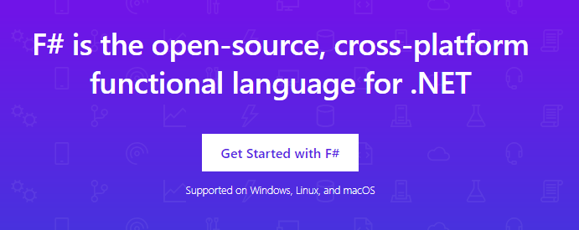
www.microsoft.com/net/

Slide 3
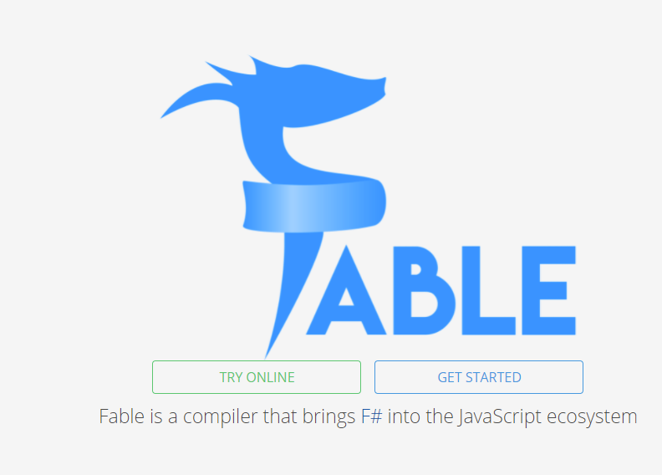

Slide 4






F# get started dotnet new -lang F# dotnet build
F# tools are part of the .NET SDK, available everywhere

Slide 5

F# for the backend dotnet new -i "giraffe-template::*" dotnet giraffe
A functional ASP.NET Core micro web framework for building rich web applications.
F# offers extremely high-performance functional-first server-side programming
github.com/giraffe-fsharp/Giraffe

Slide 6
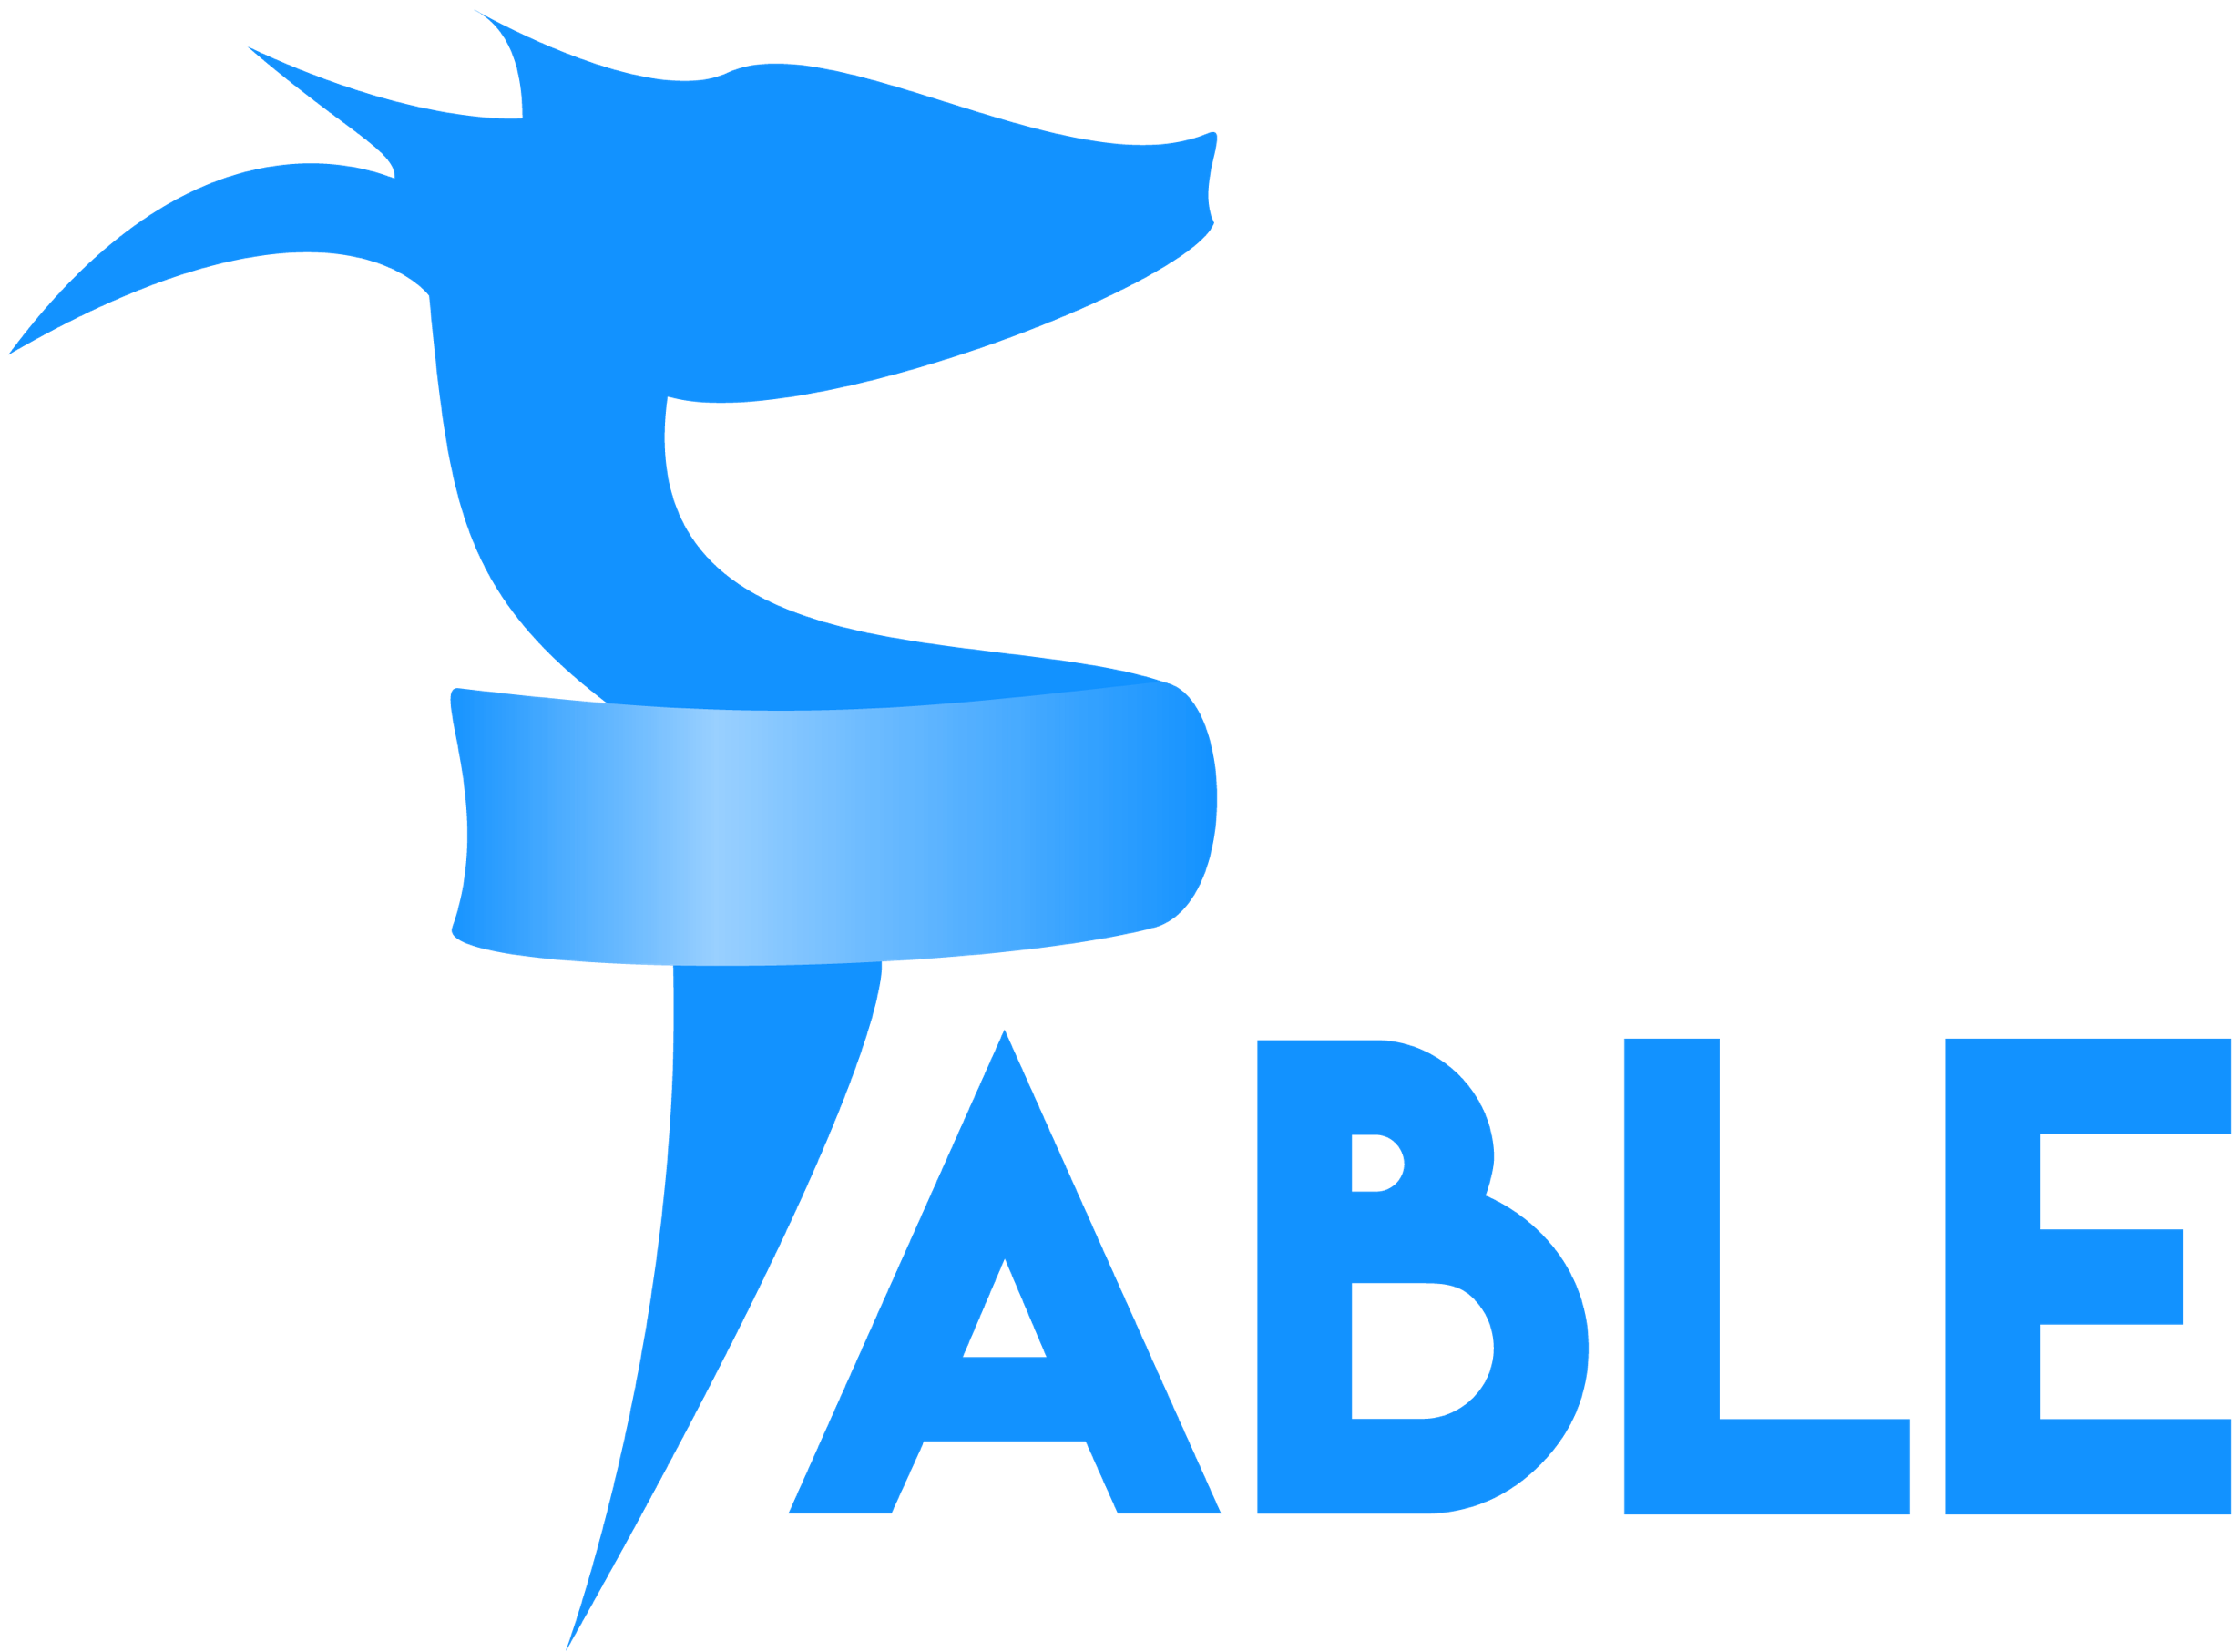
F# for the frontend (JS) dotnet new -i "Fable.Template::*" dotnet new fable npm install npm start
Like Typescript, F# lives happy in the node/npm ecosystem. You can use F# as a Javascript-first language

Slide 7
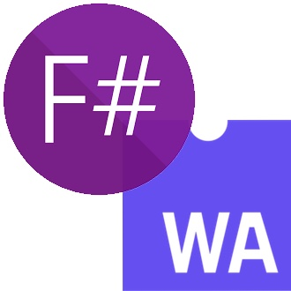
F# for the frontend (WASM) dotnet new -i Bolero.Templates dotnet new bolero-app dotnet run

Slide 8


F# for the full stack dotnet new -i SAFE.Template dotnet new SAFE dotnet tool restore dotnet fake run
=
+
This is the best thing. It powers real businesses including Norway’s NRK

Slide 9
Functional-First
I've been coding in F# lately, for a production task. F# allows you to move smoothly in your programming style... I start with pure functional code, shift slightly towards an object-oriented style, and in production code, I sometimes have to do some imperative programming.
I can start with a pure idea, and still finish my project with realistic code. You're never disappointed in any phase of the project!
Julien Laugel, Chief Software Architect, www.eurostocks.com

Slide 10
A functional-first approach makes a huge difference in practice fsharp.org/testimonials

Slide 11
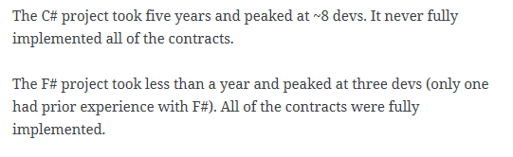
An analysis (Simon Cousins, Energy Sector)
350,000
lines of C# OO
by offshore team
30,000
lines of robust F#, with
parallel +more features
An application to evaluate the revenue due from Balancing Services contracts in the UK energy industry
http://simontcousins.azurewebsites.net/does-the-language-you-use-make-a-difference-revisited/

Slide 12
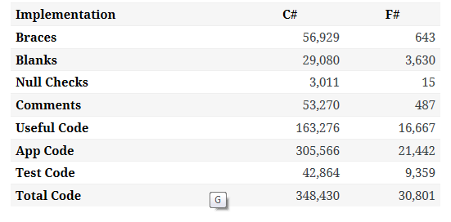

Slide 13
Simon Cousins, Energy Sector
Zero
bugs in deployed system
“F# is the safe choice for this project,
any other choice is too risky”
An application to evaluate the revenue due from Balancing Services contracts in the UK energy industry
http://simontcousins.azurewebsites.net/does-the-language-you-use-make-a-difference-revisited/

Slide 14
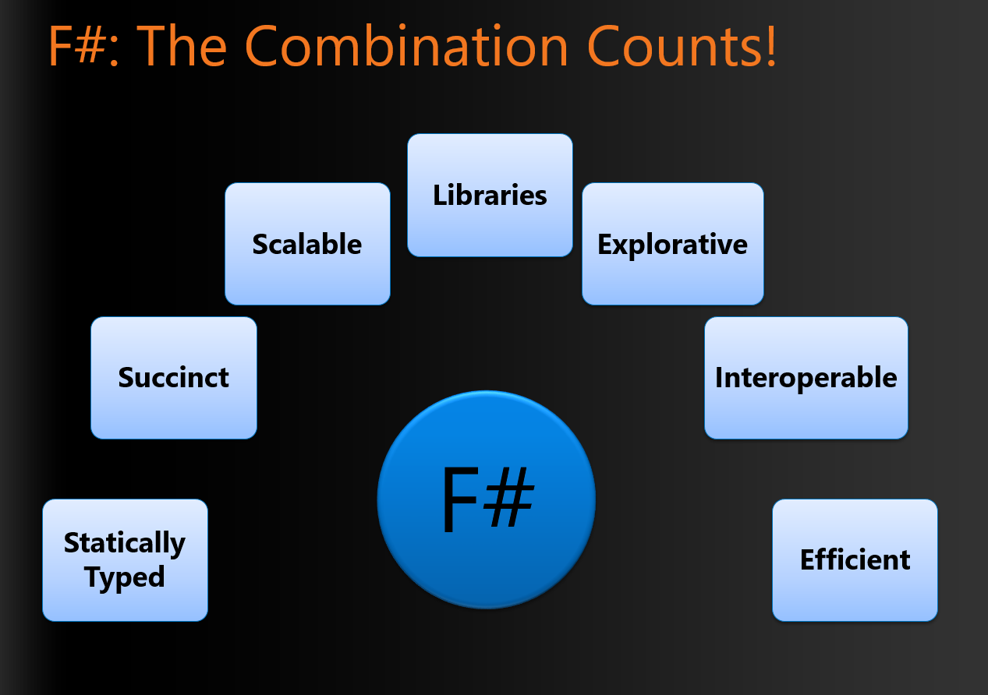
Foundations of the F# Design (~2007)

Slide 15
F# - Objects + Functional
type Vector2D (dx:double, dy:double) =
let d2 = dx*dx+dy*dy
member v.DX = dx
member v.DY = dy
member v.Length = sqrt d2
member v.Scale(k) = Vector2D (dx*k, dy*k)
Inputs to object
construction
Object internals
Exported properties
Exported method

Slide 16
Objects
Constructed Class Types
type ObjectType(args) =
let internalValue = expr
let internalFunction args = expr
let mutable internalState = expr
member x.Prop1 = expr
member x.Meth2 args = expr
Object Expressions
{ new IObject with
member x.Prop1 = expr
member x.Meth1 args = expr }
{ new Object() with
member x.Prop1 = expr
interface IObject with
member x.Meth1 args = expr
interface IWidget with
member x.Meth1 args = expr }
Object Interface Types
type IObject =
interface ISimpleObject
abstract Prop1 : type
abstract Meth2 : type -> type

Slide 17
Code I love: Functional computation of encapsulated tables and summaries
Information in
An early example (FsLexYacc):
/// Gives an index to each LR(0) kernel
type KernelTable(kernels) =
let kernelsAndIdxs = List.indexed kernels
let kernelIdxs = List.map fst kernelsAndIdxs
let toIdxMap = Map.ofList [ for i,x in kernelsAndIdxs -> x,i ]
let ofIdxMap = Array.ofList kernels
member _.Indexes = kernelIdxs
member _.Index(kernel) = toIdxMap.[kernel]
member _.Kernel(i) = ofIdxMap.[i]
Encapsualted computation
Information out

Slide 18
Deconstructing Object Programming

Slide 19
20+ features of OO
dot notation (x.Length)
instance members
type-directed name resolution
implicit constructors
static members
indexer notation arr.[x]
named arguments
optional arguments
interface types
mutable data
defining events
defining operators on types
auto properties
IDisposable, IEnumerable
type extensions
structs
delegates
enums
implementation inheritance
nulls and Unchecked.defaultof<_>
method overloading
curried method overloads
protected members
self types
wildcard types
aspect oriented programming …
…
???

Slide 20
Some make F# a better API language Some make F# a better implementation language Some are part of an interop standard Some are not needed

Slide 21
Where do we stand?
Embrace
dot notation (x.Length)
instance members
type-directed name resolution
implicit constructors
static members
indexer notation arr.[x]
named arguments
optional arguments
interface types and implementations
mutable data
operators on types
auto properties
IDisposable, IEnumerable
type extensions
events
structs
delegates
enums
type casting
large type hierarchies
implementation inheritance
nulls and Unchecked.defaultof<_>
pervasive method overloading
curried method overloads
protected members
self types
wildcard types
aspect oriented programming …
…
Down the object rabbit hole
Use where necessary, use tastefully, use respectfully, use sparingly
Not supported

Slide 22
The 20+ features of OO
Love
dot notation (x.Length)
instance members
type-directed name resolution
implicit constructors
static members
indexer notation arr.[x]
named arguments
optional arguments
interface types and implementations
mutable data
operators on types
auto properties
IDisposable, IEnumerable
type extensions
events
structs
delegates
enums
type casting
large type hierarchies
implementation inheritance
nulls and Unchecked.defaultof<_>
pervasive method overloading
curried method overloads
protected members
self types
wildcard types
aspect oriented programming …
…
Mostly Avoid
Tolerate
Forget

Slide 23
Object Programming v. Object-Oriented Programming

Slide 24
Object Programming focuses on … succinct coding, notational convenience API ergonomics good naming practical encapsulation sensible, small, composable abstractions expression-oriented making simple things out of (potentially complex) foundations works well with expression-oriented programming

Slide 25
In the extreme Object-Oriented Programming can be… objects as a single paradigm hierarchical classification (Animal, Cat, Dog, AbstractJellyBeanFactoryDelegator) large abstractions with many holes and failure points declarations not expressions composition through… more hierarchies

Slide 26
The F# approach is to embrace object programming, make it fit with the expression-oriented typed functional paradigm but not embrace full “object-orientation” (unless you happen to be in a project using that technique)

Slide 27
This is a typical Client/Server App
REST API
Server
Web Client
F#
F#
.NET
JavaScript

Slide 28
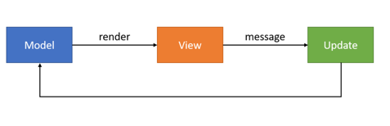
The Web Client uses “Model View Update” c.f. React
REST API
Web Client
view
dispatch
update

Slide 29
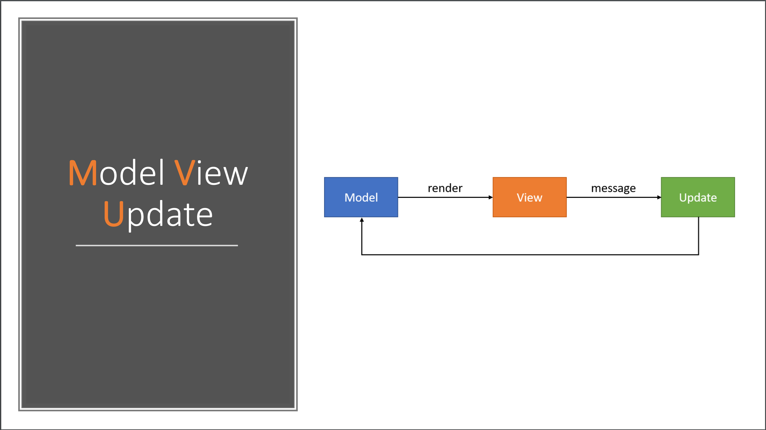

Slide 30
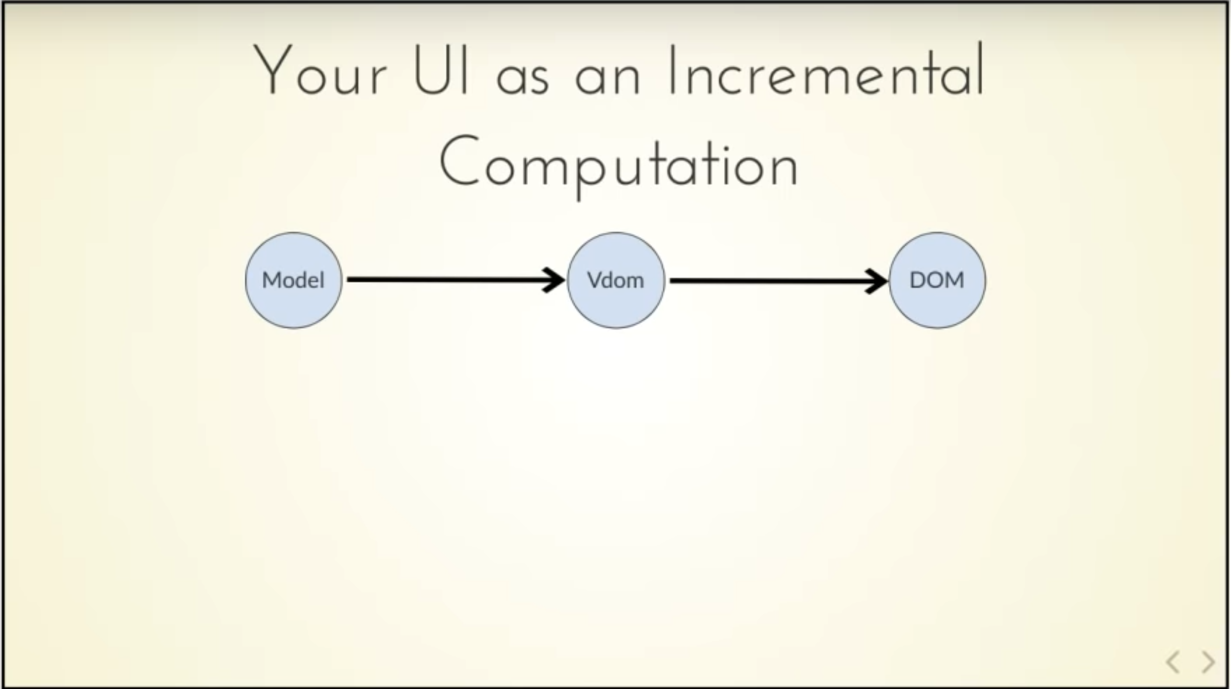
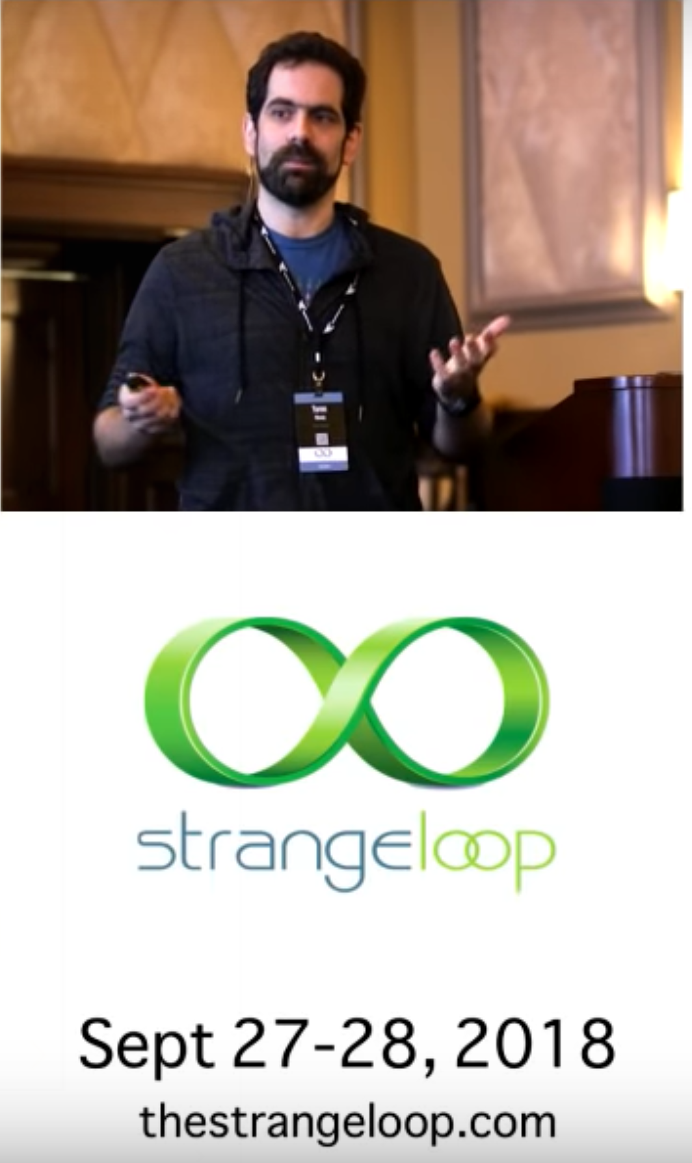
view

Slide 31
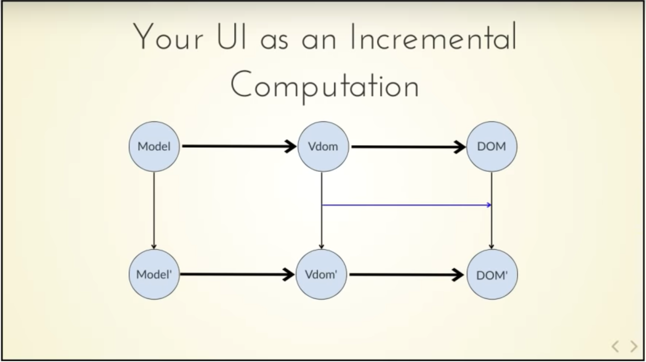
Δ
view
update
Δ
view

Slide 32
Code I love: computation expressions

Slide 33
seq { … } [ … ] [| … |] async { … } option { … } task { … } taskSeq { … } asyncOption { … } ….
“extensible, intuitive, friendly monadic notation on steroids”

Slide 34
seq { … }, [ … ], [| … |]
✗
let rec allSymbolsInEntities compGen (entities: FSharpEntitylist) =
List.concat [
entities;
(e.GenericParameters
|> List.filter (fun gp -> compGen || not gp.IsCompilerGenerated));
(e.MembersFunctionsAndValues
|> List.filter (fun x -> compGen || not x.IsCompilerGenerated)
|> List.collect (fun x ->
List.cons x
(x.GenericParameters
|> List.filter (fun gp -> compGen || not gp.IsCompilerGenerated))));
e.UnionCases;
(x.UnionCaseFields
|> List.filter (fun f -> compGen || not x.IsCompilerGenerated));
(x.Fields
|> List.filter (fun f -> compGen || not x.IsCompilerGenerated));
allSymbolsInEntities compGen e.NestedEntities ]
let rec allSymbolsInEntities compGen (entities: FSharpEntitylist) =
[ yield! entities
for gp in e.GenericParameters do
if compGen || not gp.IsCompilerGenerated then
yield gp
for x in e.MembersFunctionsAndValues do
if compGen || not x.IsCompilerGenerated then
yield x
for gp in x.GenericParameters do
if compGen || not gp.IsCompilerGenerated then
yield gp
yield! e.UnionCases
for f in x.UnionCaseFields do
if compGen || not f.IsCompilerGenerated then
yield f
for x in e.FSharpFields do
if compGen || not x.IsCompilerGenerated then
yield x
yield! allSymbolsInEntities compGen e.NestedEntities ]
Many examples, almost every page of code
Alternative is explicit append etc
Typically much more expressive than other comprehension notations
✓
v.

Slide 35
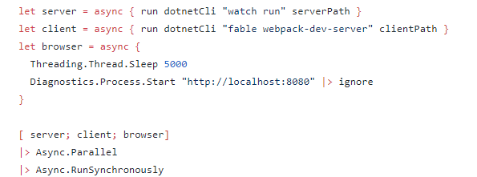
async { … }
One example:
v.

Slide 36
asyncSeq { … }
let withTime =
asyncSeq {
do! Async.Sleep 1000 // non-blocking sleep
yield 1
do! Async.Sleep 1000 // non-blocking sleep
yield 2
}
It’s a library
No inversion of control, you think in a “forward” way
let intervalMs (periodMs:int) =
asyncSeq {
yield DateTime.UtcNow
while true do
do! Async.Sleep periodMs
yield DateTime.UtcNow
}
v.
https://fsprojects.github.io/FSharp.Control.AsyncSeq/

Slide 37
I love…
Please, implement .ToString() and DebuggerDisplay to aid debugging
Code that can be debugged
Code that is commented
Code that is tested
Code that is performant
Code that is under CI
Code that is readable
Please, use good variable names
Please, use good method names and seek good stack traces
Please, comment your code well

Slide 38
What’s coming in F# 5.1/6.0…?
high-perf computation expressions
tasks
anonymous unions
inline-if-lambda
additional type-directed conversions for better interop

Slide 39
In Closing

Slide 40
F# Emphasises Clear Code to Solve Real-world Problems
Simple, clear code is the F# Code I Love
Object Programming
<>
Object-Oriented Programming
Not all Functional Code is Good Code

Slide 41
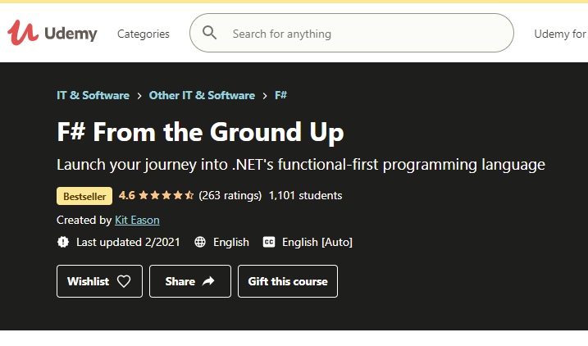

Thanks! Questions?

